Slide 1
FILE INTEGRITY MONITOR FOR HOST & NETWORKED ENVIRONMENTS (pyFIM)
Checksum verification and alerting
By Tinashe Gondwa
H170192A(HIT400 Capstone Project)

Slide 2
Introduction
FIM is simply the technique of keeping watch of the data and how it has been changed. Integrity is one of the pillars of the CIA triad of information security. To better understand this concept, the phrase can be broken down into individual words – file, integrity and monitor. The term file refers to data or information that is actually stored on the computer or network. The integrity of the file means that it has not been maliciously altered or modified. Monitoring refers to constantly checking the file to see whether there have been any modifications done to it. This check will verify whether the integrity of the data is maintained or not

Slide 3
Problem Statement
Enterprises firms and institutions store critical information about their customers on their organisational servers. Each server performs some form of response to client or user requests. If a response is given to a malicious user, it could lead to loss of critical data. The need for scalable security monitoring in such dynamic environments has become a critical need.

Slide 4
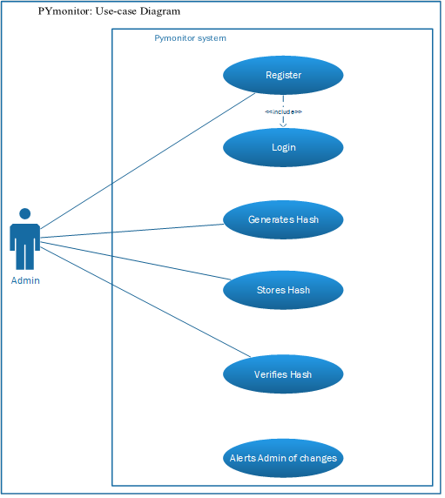
Use-Case

Slide 5
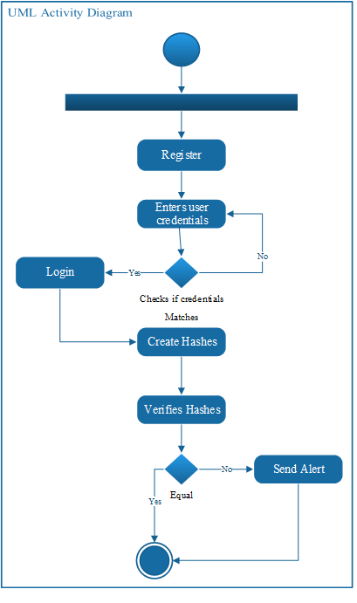
Activity Diagram

Slide 6
Objectives
To generate checksums for files to be monitored
To compare the stored checksum of a file with its current checksum
To send an email alert if the compared checksums for a file are not equal

Slide 7
DEMONSTRATION

